Slide 1
Chapter 2
A Simple Compiler
1

Slide 2
In this chapter, we will describe a simple programming language called:
adding calculator (ac).
Then, describe a simple compiler for ac.

Slide 3
Definition of ac language
Regular expression specifies Token
The actual input characters that correspond to each terminal symbol (called token) are specified by regular expression.
For example:
assign symbol as a terminal, which appears in the input stream as “=“ character.
The terminal id (identifier) could be any alphabetic character except f, i, or p, which are reserved for special use in ac. It is specified as [a-e] | [g-h] ] | [j-o] | [q-z]
Regular expression will be covered in Ch. 3.
3

Slide 4
Definition of ac language (Cont.)
4

Slide 5
Sample AC Program
f b // declare a floating variable
i a // declare an integer variable
a = 5 // a single character identifier
b = a + 3.2
p b // print the variable

Slide 6
Adding calculator (ac) grammar
A context-free grammar (CFG) specifies the syntax of a language. It is:
A set of productions
(or rewriting rules).

Slide 7
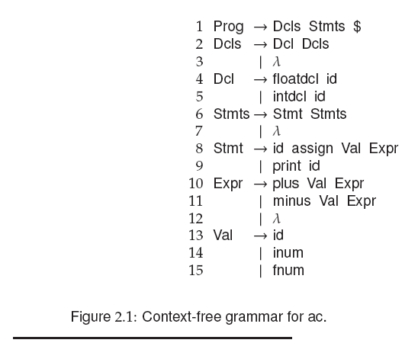
The grammar for ac:
7

Slide 8
Definition of ac language
Two kinds of grammar symbols:
terminal (token) and non-terminal.
1) A terminal cannot be rewritten.
2) A non-terminal can be rewritten by a production rule.
A special non-terminal is start symbol, which is usually the symbol on the left-hand side (LHS) of the grammar’s first rule.
From the start symbol, we proceed by replacing (rewriting) a symbol with the right-hand side (RHS) of some production of that symbol.

Slide 9
Definition of ac language (Cont.)
The symbol λ denotes empty or null string, which indicates that there are no symbols on a production’s RHS.
The special symbol $ represents the end of the input stream.
To show how the grammar in Fig. 2.1 defines ac programs, the derivation of one ac program is given in Fig. 2.2, beginning with:
The start symbol Prog.

Slide 10
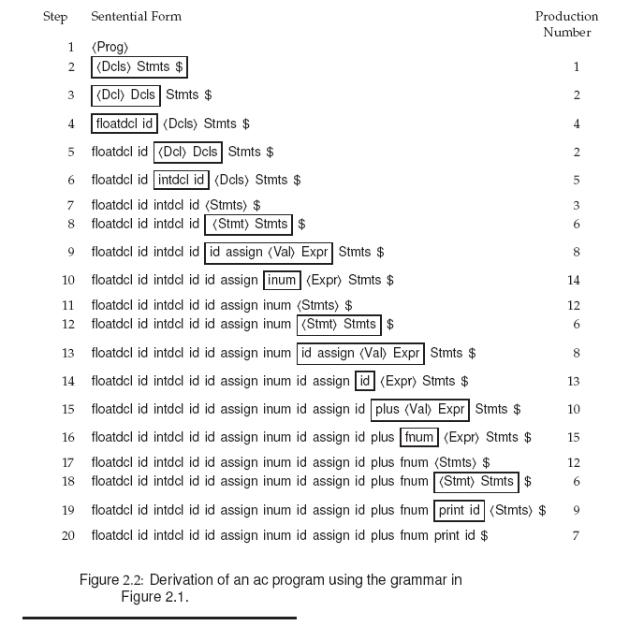
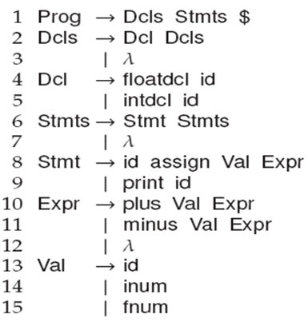
10

Slide 11
Definition of ac language (Cont.)
11

Slide 12
Phases of an ac compiler
Scanning
The scanner reads a source ac program as a text file and produces a stream of tokens.
Fig. 2.5 shows a scanner that finds all tokens for ac.
Fig. 2.6 shows scanning a number token.
Each token has the two components:
1)Token type explains the token’s category. (e.g., id)
2)Token value provides the string value of the token. (e.g., “b”)

Slide 13
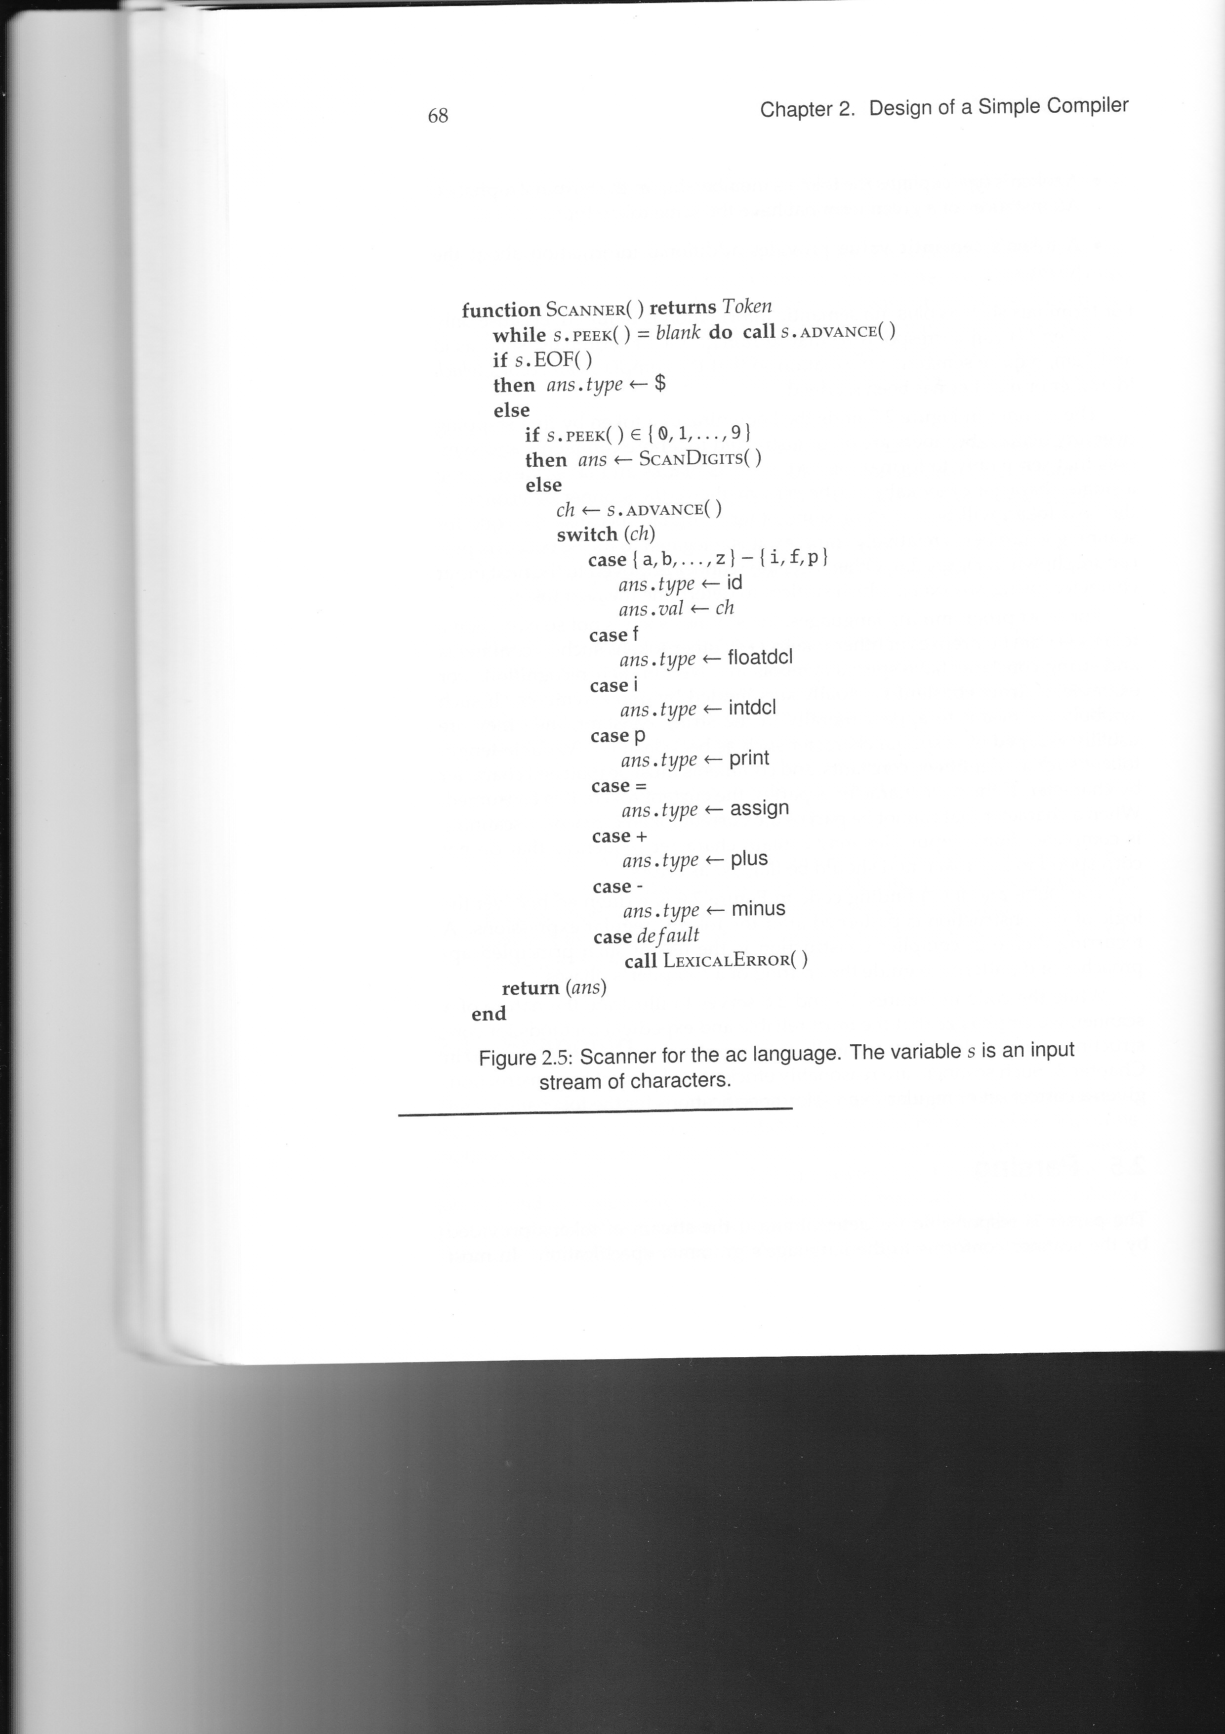

Slide 14
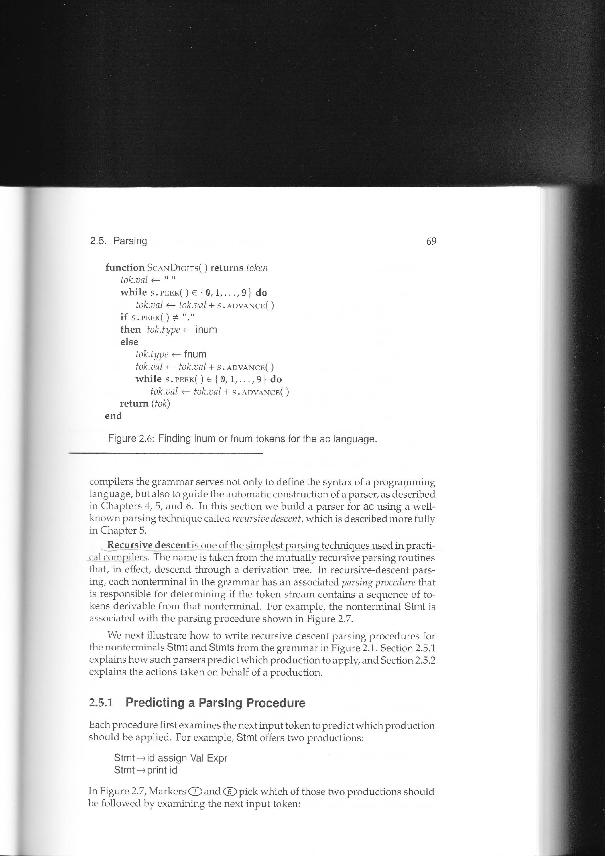

Slide 15
Phases of an ac compiler (Cont.)
Parsing
Parser processes tokens produced by the scanner, determines the syntactic validity of the token stream, and creates an abstract syntax tree (AST) for subsequent phases.
Recursive descent (LL type parser) is one simple parsing technique used in practical compilers.
The parsing procedure for “Stmt” is shown in Fig. 2.7.

Slide 16
Definition of ac language (Cont.)
16

Slide 17
Phases of an ac compiler (Cont.)
Each parsing procedure examines the next input token to predict which production to apply. Ex:
Stmt offers two productions:
Stmt → id assign Val Expr
Stmt → print id

Slide 18
Phases of an ac compiler (Cont.)
If id is the next input token, the parse proceeds with the production:
Stmt → id assign Val Expr
and the predict set for the production is {id}.
If print is the next, the parse proceeds with:
Stmt → print id
the predict set for the production is {print}.
If the next input token is neither id nor print,
neither rule can be applied. (aka, syntax error)

Slide 19
Notes
OK, we can peek (lookahead) to choose a production to expand (rewrite) if two or more productions are available
If a lookahead cannot determine a single production to rewrite, what happens? (See future chapters)
Rewrite grammar
Peek more lookaheads

Slide 20
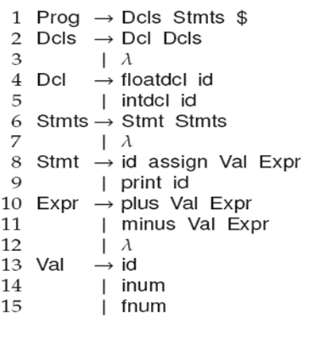
Phases of an ac compiler (Cont.)
Computing the predict sets used in Stmt is relatively easy,
because each production for Stmt begins with a distinct terminal symbol:
id or print
In fig 2.7, markers 1 and 6 pick which of the two productions to apply by examining the next input token.

Slide 21
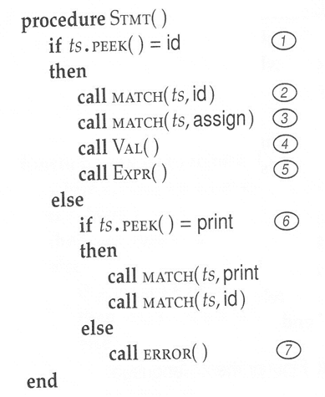

Slide 22
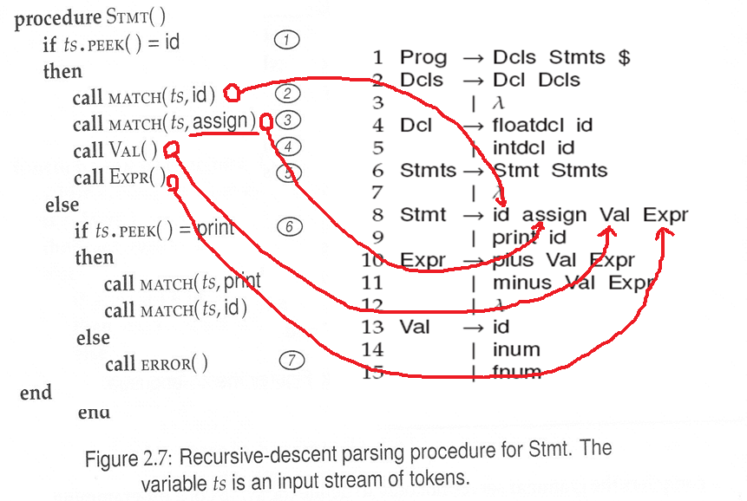
For each production, write the LHS code

Slide 23
Phases of an ac compiler (Cont.)
Consider the productions for Stmts:
Stmts → Stmt Stmts
Stmts → λ
The predict sets for Stmts can be computed by inspecting the following:
Stmts → Stmt Stmts
begins with the non-terminal Stmt.
Sol: Find those symbols that predict any rule for Stmt.
Stmts → λ derives no symbols.
Sol: Look for what symbol(s) could occur following such a production (that is $).

Slide 24
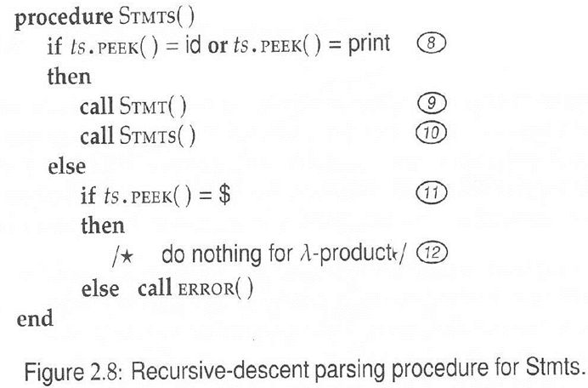
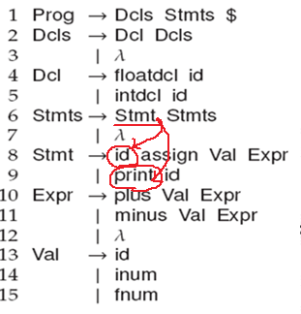
For production rule that begins with a nonterminal you still need to tell how to keep going based on peeking lookahead

Slide 25
Let’s do semantics !!
OK, when parser does parsing, there are some points that reach a point where you can do semantics. We should do a=5 here

Slide 26
Semantics Actions
You can execute semantics immediately in an interpreter
In a Compiler,
we don’t execute semantics immediately
We do not produce assembly code yet.

Slide 27
Phases of an ac compiler (Cont.)
If all of the tokens are processed, an abstract syntax tree (AST) will be generated.
An example is shown in fig 2.9.
AST serves as a representation of a program for all phases
after syntax analysis.

Slide 29
Phases of an ac compiler (Cont.)
The symbol-table constructor traverses
the AST to record
all identifiers and
their types
in a symbol table.
The constructor is shown in fig 2.10.

Slide 30

Phases of an ac compiler (Cont.)

Slide 31
Phases of an ac compiler (Cont.)
An ac symbol table has 23 identifier entries with their types:
integer, float, or unused (null).
Fig 2.11 shows the symbol table constructed.

Slide 32
Phases of an ac compiler (Cont.)

Slide 33
Phases of an ac compiler (Cont.)
Type checking
The ac language offers two types:
integer and float,
and all identifiers must be type-declared in a program before they can be used.
This process walks the AST bottom-up from its leaves toward its root.

Slide 34
Phases of an ac compiler (Cont.)
At each node, appropriate analysis is applied:
For constants and symbol references, the visitor methods simple set the supplied node’s type based on the node’s contents.
For nodes that compute value, such as plus and minus, the appropriate type is computed by calling the utility methods.
For an assignment operation, the visitor makes certain that the value computed by the second child is of the same type as the assigned identifier (the first child).
The results of applying semantic analysis to the AST of fig 2.9 are shown in fig 2.13.

Slide 35
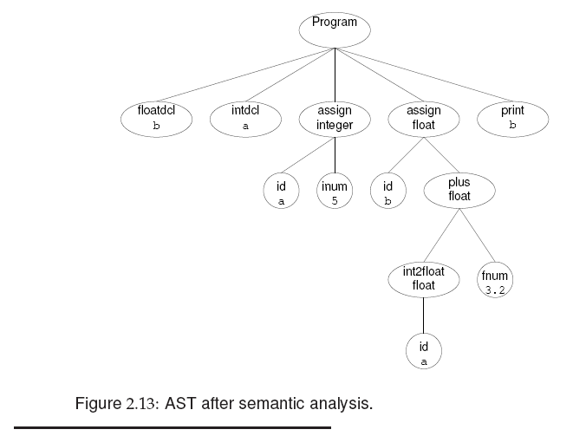

Slide 36
Phases of an ac compiler (Cont.)
Code generation
Code generation proceeds by traversing (visiting) the AST nodes, starting at its root and working toward its leaves.
A visitor generates code based on the node’s type (fig 2.14).
Fig 2.15 shows the target code generated from the AST in fig 2.9.

Slide 37
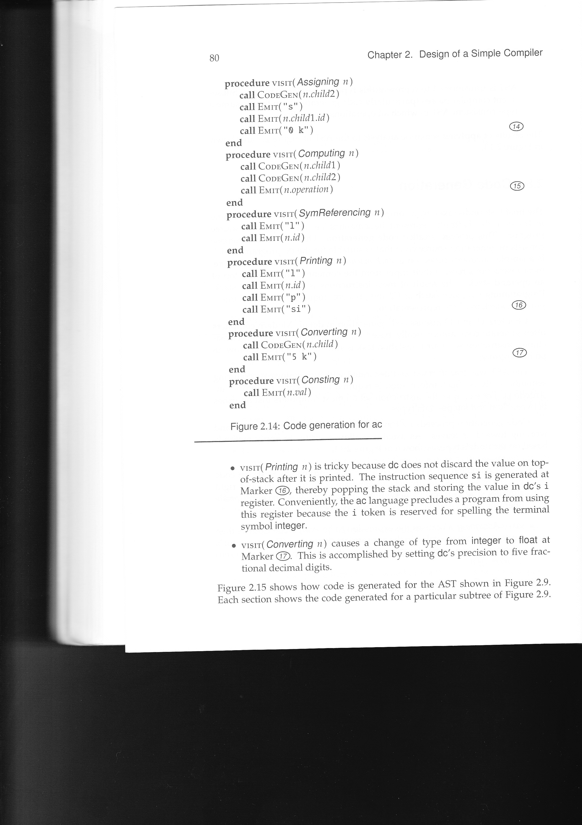

Slide 39
Homework
1. Based on the grammar in Figure 2.1, construct the parse tree for the following input:
(a) i x x=100 x=x+30+1 p x

Slide 40
HW Solution 1.(a)
Prog
$
Dcls
Stmts
Stmts
Stmt
Dcl
Dcls
Stmts
Stmt
Stmt
Stmts
intdcl
id
λ
id
assign
Val
Expr
id
assign
Val
Expr
Print
id
λ
i
x
x
=
100
λ
x
=
x
p
x
Plus
Val
Expr
+
30
Plus
Val
Expr
+
1
λ

Slide 41
Homework (Cont.)
2. For the input shown in Exercise 1:
(a) Construct the input’s AST
(b) According to the definition of ac, is the input semantically correct? If not, what changes to the ac language would render the input semantically correct?
(c) With ac changes in place that make the input semantically correct, show the code that would be generated on behalf of the input.

Slide 42
HW Solution 2.(a)
Prog
Print
x
x
=
=
x
100
x
+
x
+
30
1

Slide 43
HW Solution 2.(b)
(b) No.
we can do semantic analysis below.
In the AST, the three nodes 30, +, and 1 can be changed to one node 31.
This analysis simplifies the AST.

Slide 44
HW Solution 2.(c)
(c) 100 x=100 push 100 to stack
sx pop top of stack, store it to reg. x
0 k set precision 0
lx x=x+31 load x (push x to stack)
31 push 31 to stack
+ pop 31, pop x, add them, push the result
sx
0 k
lx p x load x (push x to stack)
p print top of stack
si pop top of stack, store it to reg. i

Slide 45
Homework (Cont.)
3. Extend the ac scanner (Figure 2.5) in the following ways:
(a) A floatdcl can be represented as either f or float, allowing a more Java-like syntax for declarations.
(b) An intdcl can be represented as either i or int
(c) A num may be entered in exponential (scientific) form. That is, an ac num may be suffixed with an optionally signed exponent (1.0e10, 123e-22 or 0.31415926535e1)

Slide 46
HW Solution 3
(a) (b)
Terminal RegularExpression
floatdcl “f” | (“f” “l” “o” “a” “t”)
intdcl “i” | (“i” “n” “t”)
(c) inum [0-9]⁺ e -? [0-9] ⁺
fnum [0-9] . [0-9]⁺ e -?[0-9] ⁺

